Slide 1
NORMALIZATION

Slide 2
Normalization
A large database defined as a single relation may result in data duplication. This repetition of data may result in:
Making relations very large.
It isn't easy to maintain and update data as it would involve searching many records in relation.
Wastage and poor utilization of disk space and resources.
The likelihood of errors and inconsistencies increases.

Slide 3
Normalization
So to handle these problems, we should analyze and decompose the relations with redundant data into smaller, simpler, and well-structured relations that are satisfy desirable properties.
Normalization is a process of decomposing the relation into relations with fewer attributes.

Slide 4
What is Normalization???
Normalization is the process of organizing the data in the database.
Normalization is used to minimize the redundancy from a relation or set of relations.
It is also used to eliminate undesirable characteristics like Insertion, Update, and Deletion Anomalies.
Normalization divides the larger table into smaller and links them using relationships.
The normal form is used to reduce redundancy from the database table.

Slide 5
Data Modification Anomalies
Insertion Anomaly: Insertion Anomaly refers to when one cannot insert a new tuple into a relationship due to lack of data.
Deletion Anomaly: The delete anomaly refers to the situation where the deletion of data results in the unintended loss of some other important data.
Updation Anomaly: The update anomaly is when an update of a single data value requires multiple rows of data to be updated.

Slide 6
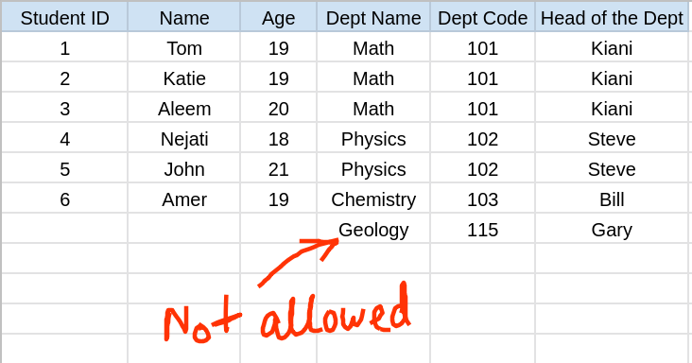
Insertion Anomaly

Slide 7
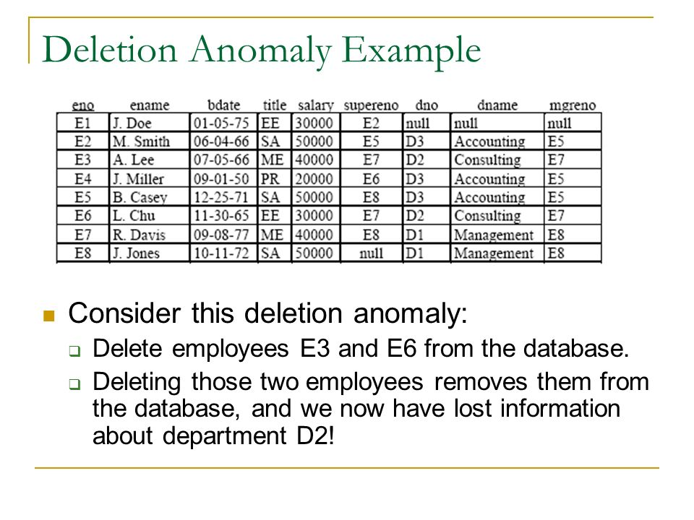
Deletion Anomaly

Slide 8
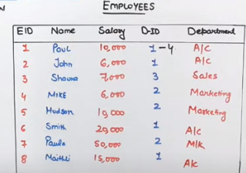
Updation Anomaly

Slide 9
Why Normalization is required?
The main reason for normalizing the relations is removing these anomalies.
Failure to eliminate anomalies leads to data redundancy and can cause data integrity and other problems as the database grows.
Normalization consists of a series of guidelines that helps to guide you in creating a good database structure.

Slide 10
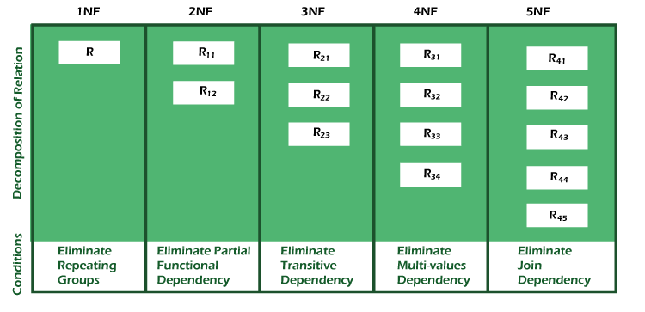
Types of Normal Forms

Slide 11
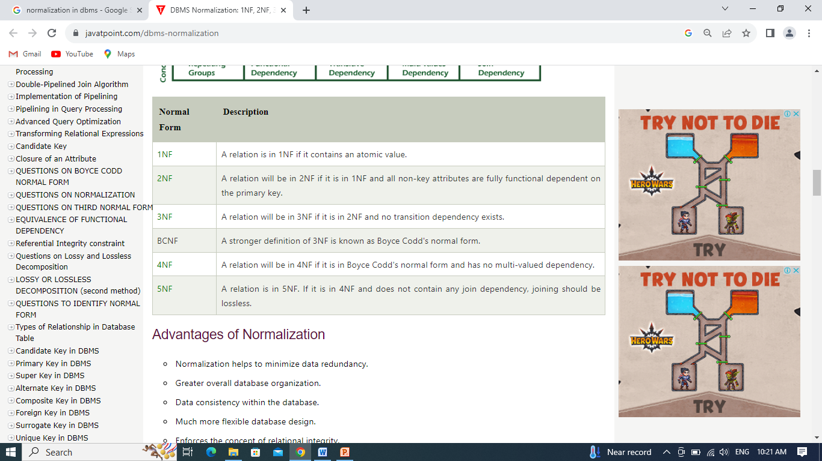
Types of Normal Forms

Slide 12
Advantages of Normalization
Normalization helps to minimize data redundancy.
Data consistency within the database.
Much more flexible database design.
Enforces the concept of relational integrity.

Slide 13
Disadvantages of Normalization
You cannot start building the database before knowing what the user needs.
The performance degrades when normalizing the relations to higher normal forms, i.e., 4NF, 5NF.
It is very time-consuming and difficult to normalize relations of a higher degree.
Careless decomposition may lead to a bad database design, leading to serious problems.

Slide 14
Thank You

